Slide 1
News in Pictures
2nd National Congress on Clinical Diabetes – 14th and 15th April, 2018

Slide 2
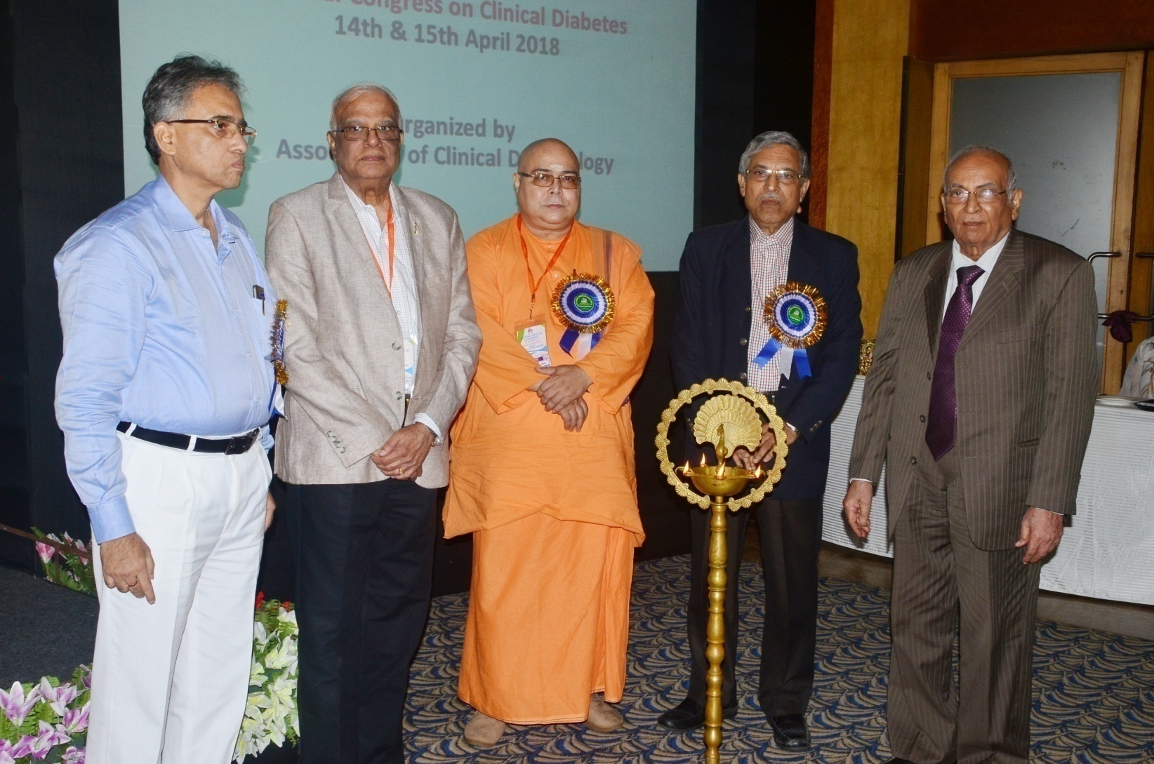
1. Inauguration of the conference by Dr B K Sahay, Prof. V Seshiah, Prof. Samar Banerjee, Swami Nityakamanand, Prof Jotideb Mukhopadhyay

Slide 3
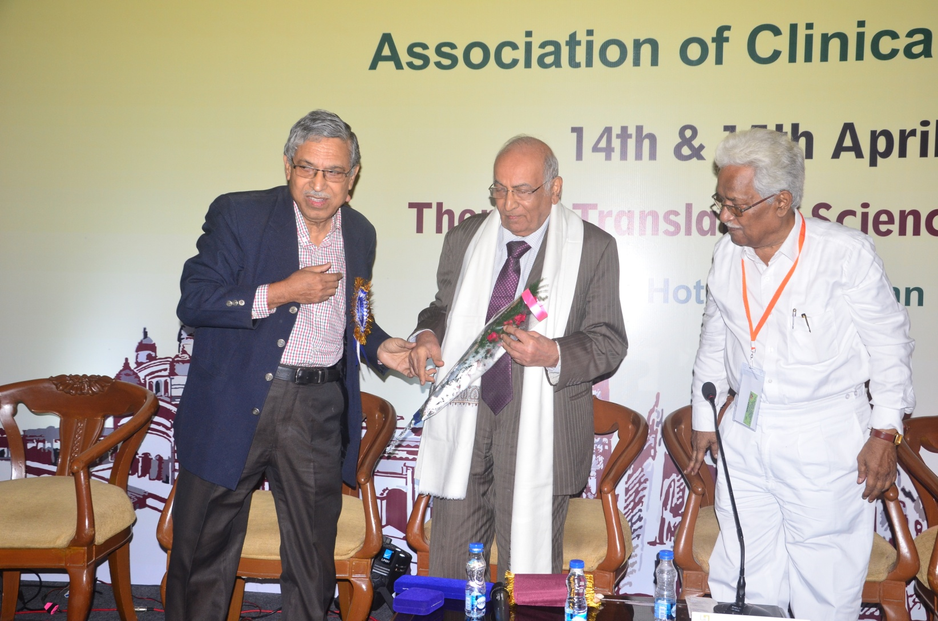
2. Prof B K Sahay receiving lifetime achievement award from Prof. Samar Banerjee & Prof R K Duttaroy

Slide 4
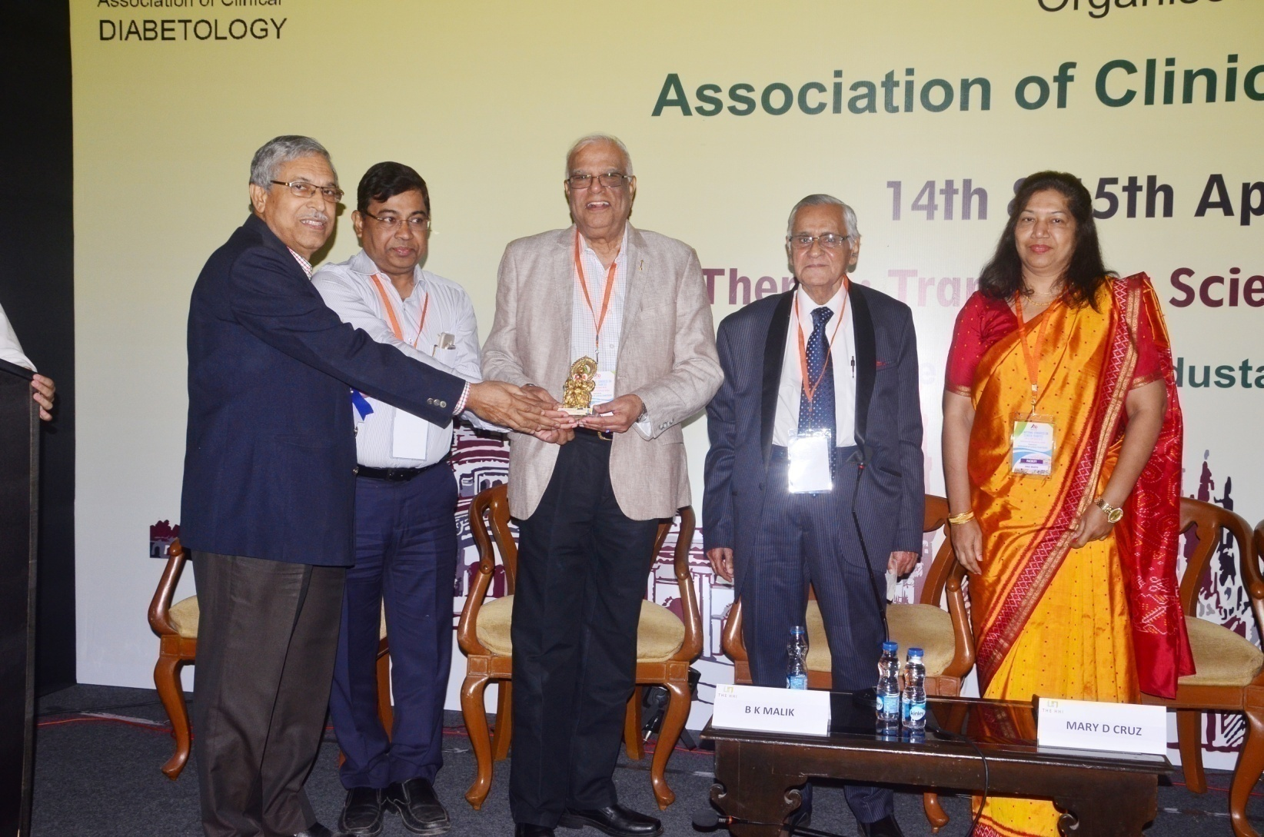
3. Prof V Seshiah receiving a momento from Prof. Samar Banerjee, Prof . Soumitra Ghosh, Dr. Bidyut Mallik, Dr. Mary D Cruz

Slide 5
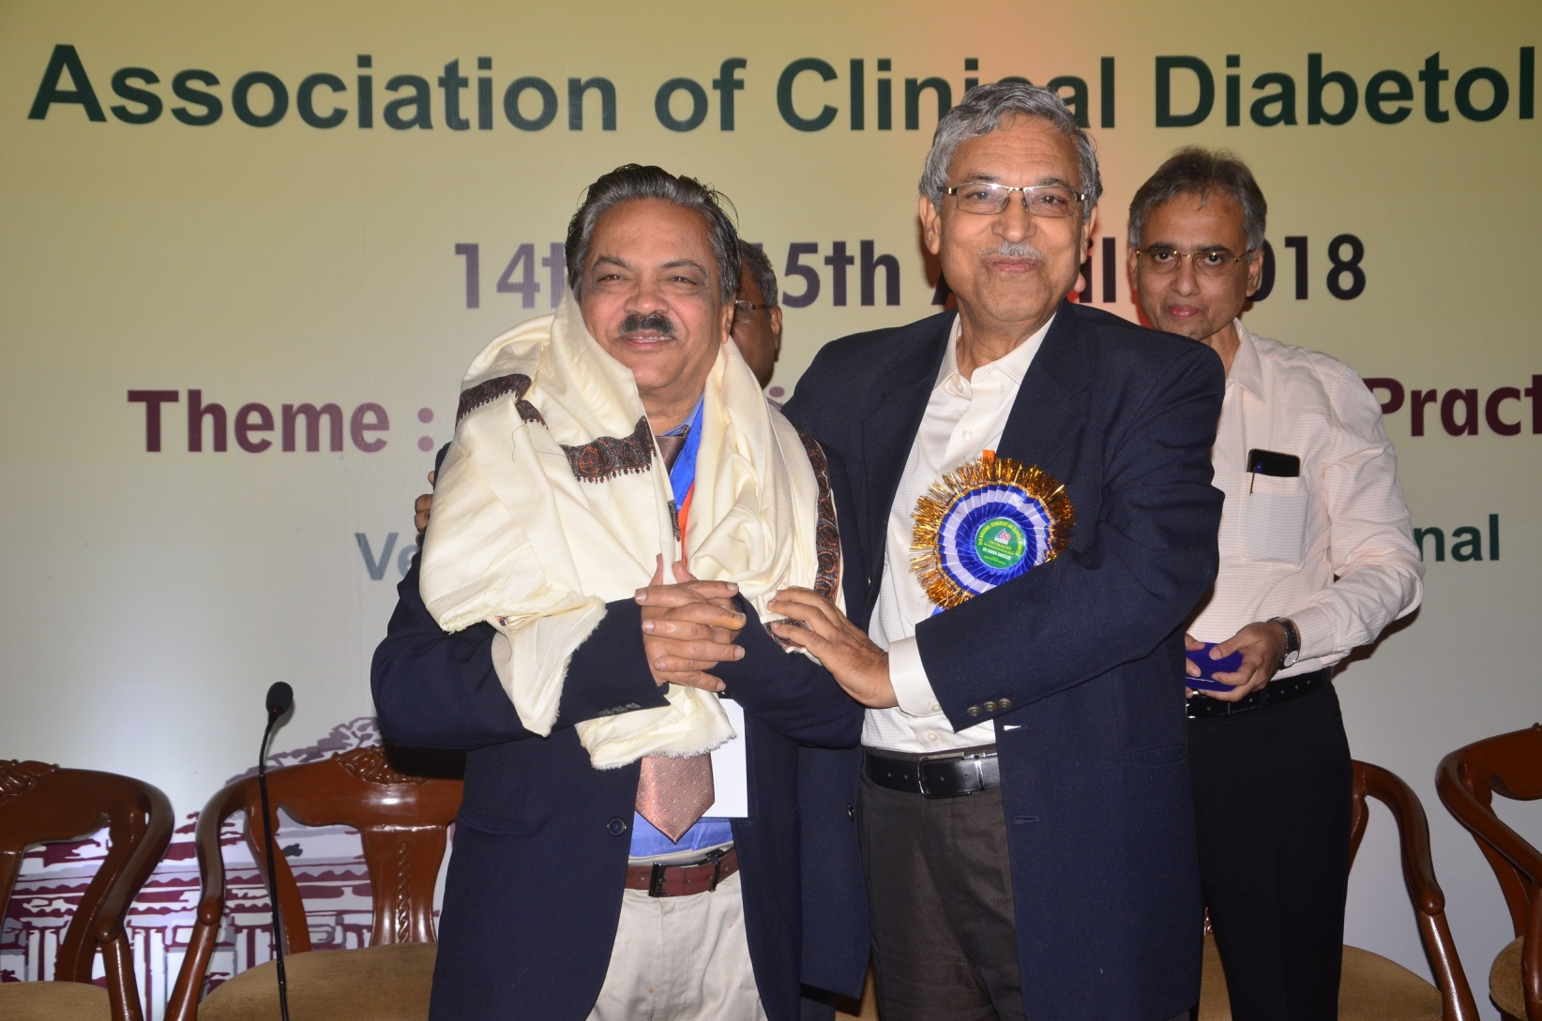
4. Prof A K Das, being felicitated by Prof. Samar Banerjee and Prof Jotideb Mukhopadhyay

Slide 6
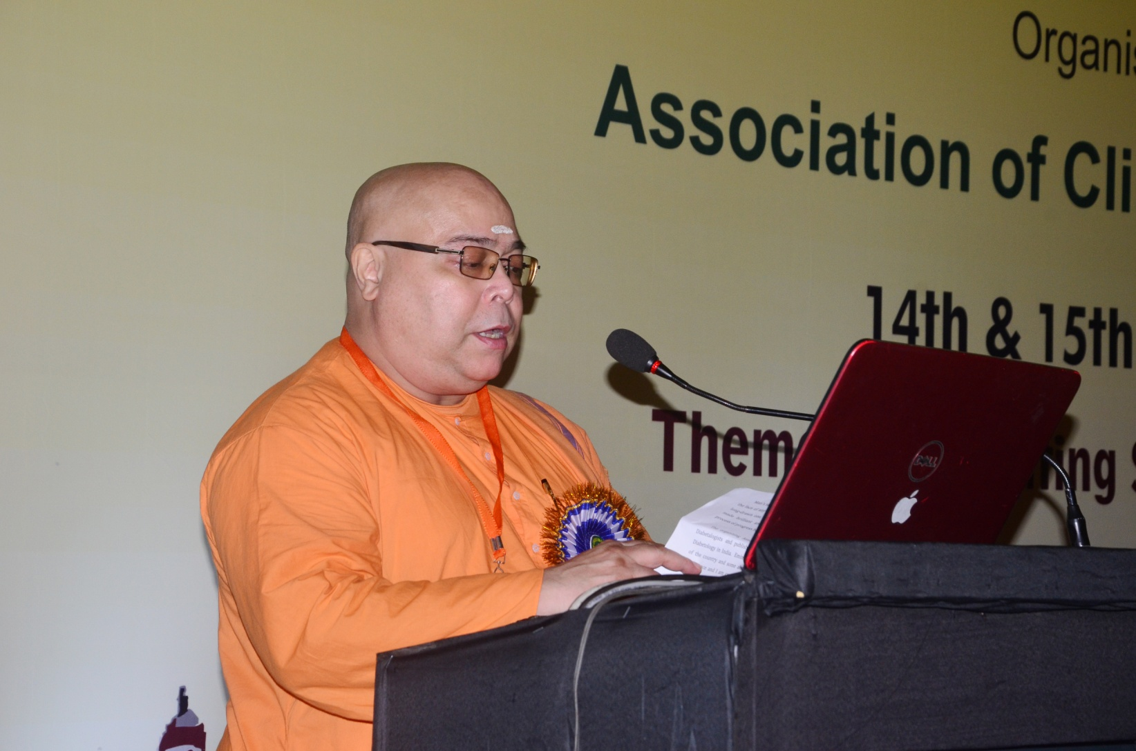
5. Swami Nityakamananda delivering his inaugural address

Slide 7
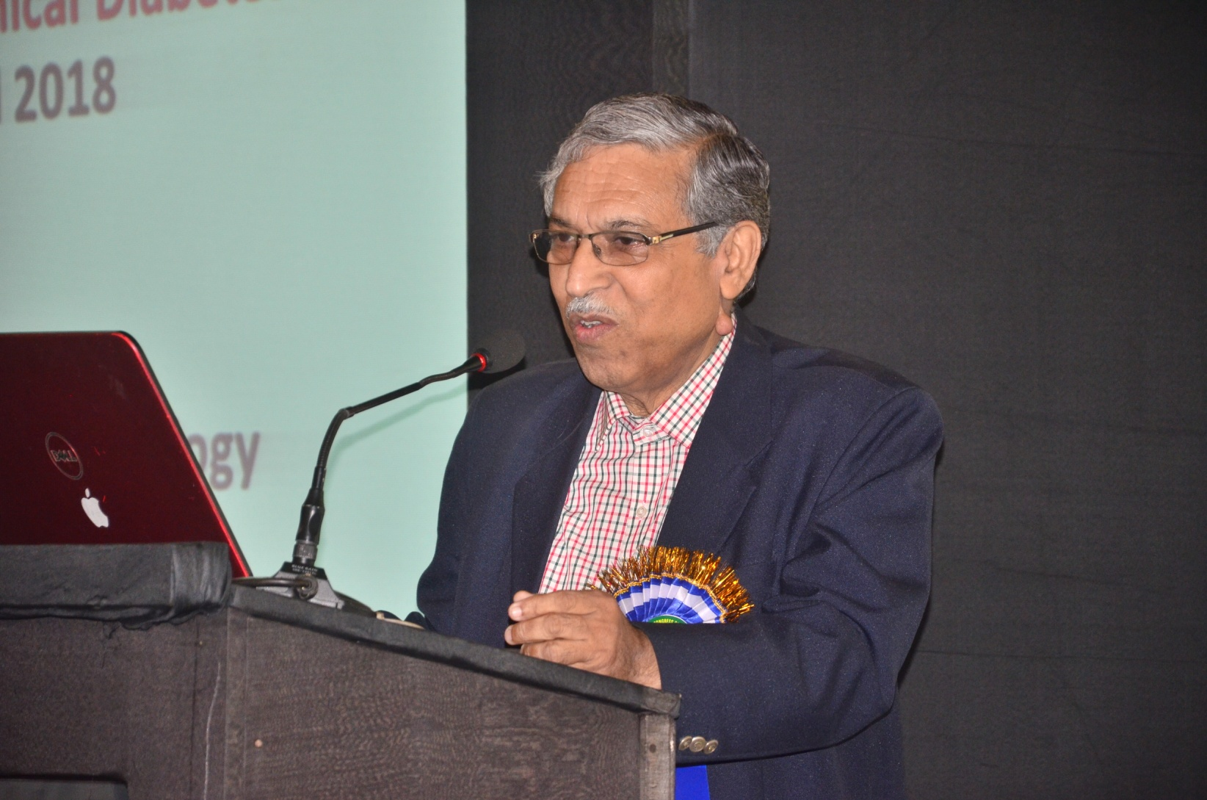
6. Prof. Samar Banerjee delivering his lecture on Evidences for Metformin

Slide 8
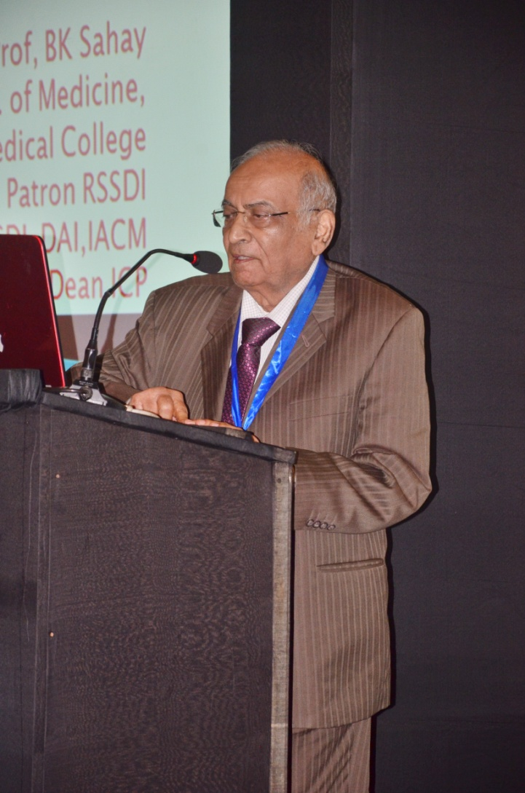
7. Prof B K Sahay delivering his oration on ‘My Journey with Diabetes’

Slide 9
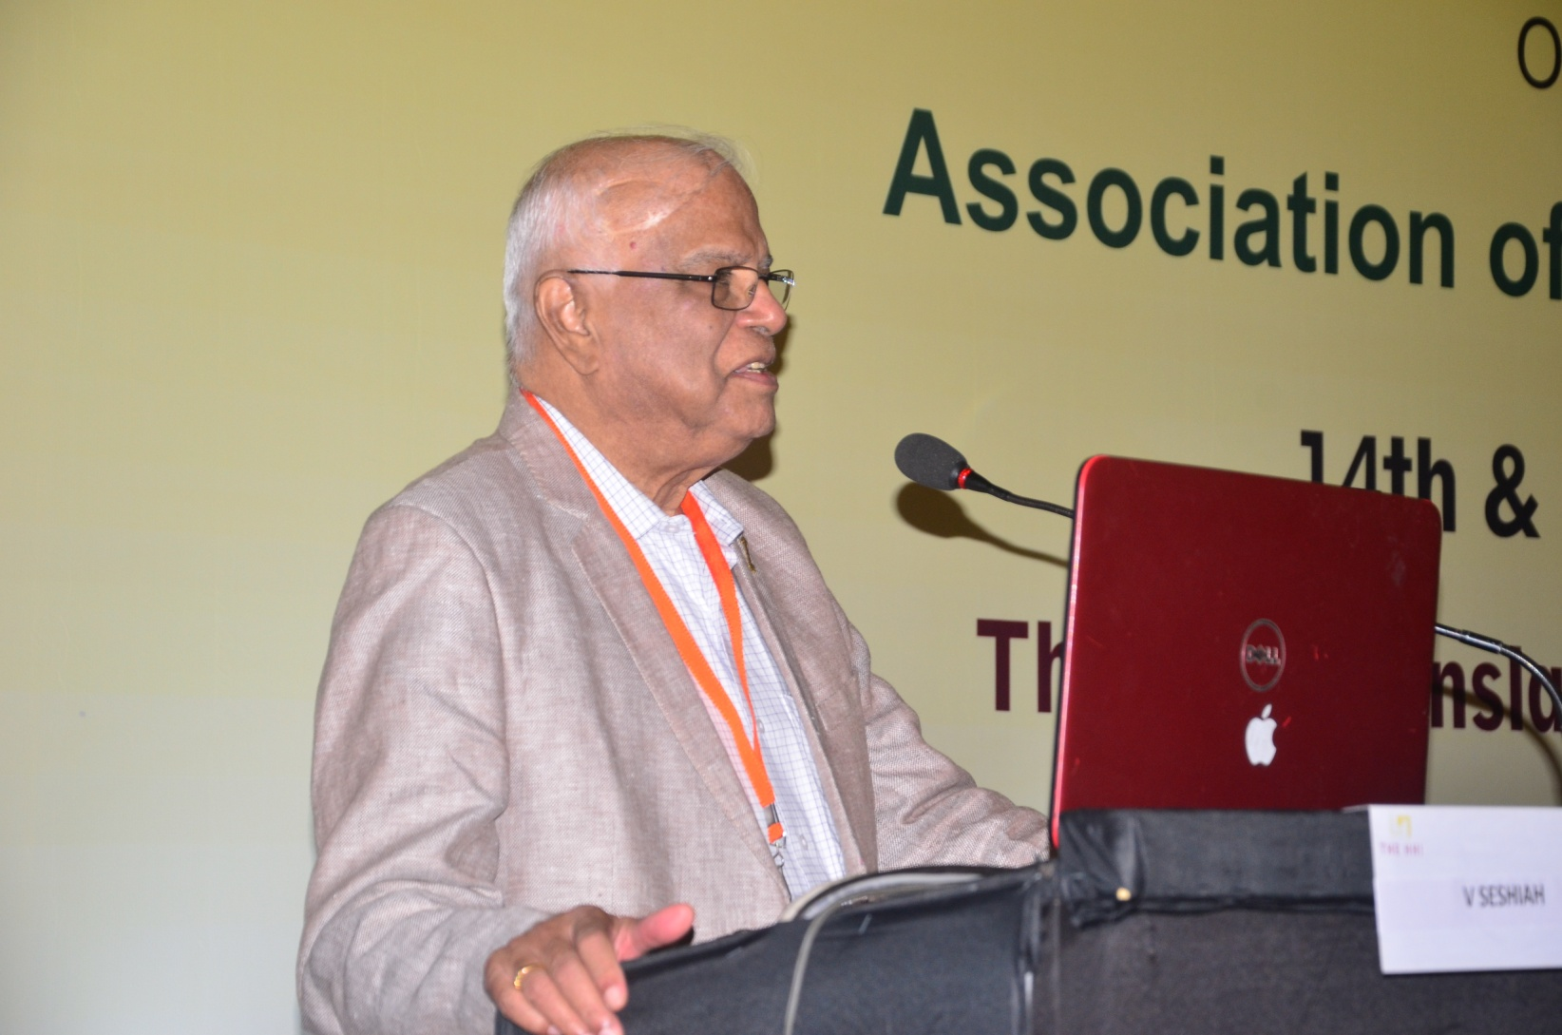
8. Prof V Seshiah delivering his lecture on Prevention of Non Communicable diseases – ‘Whom to focus’?

Slide 10
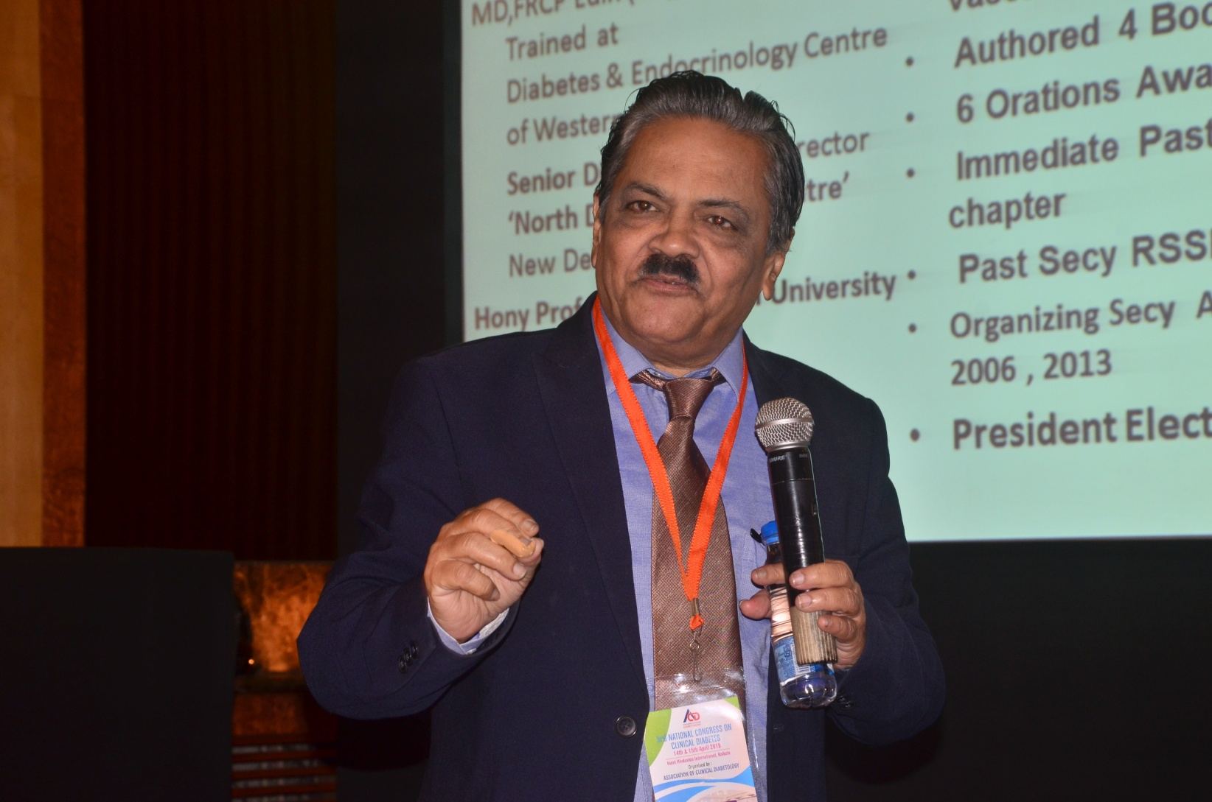
9. Prof A K Das delivering his oration on Diabetes and Heart

Slide 11
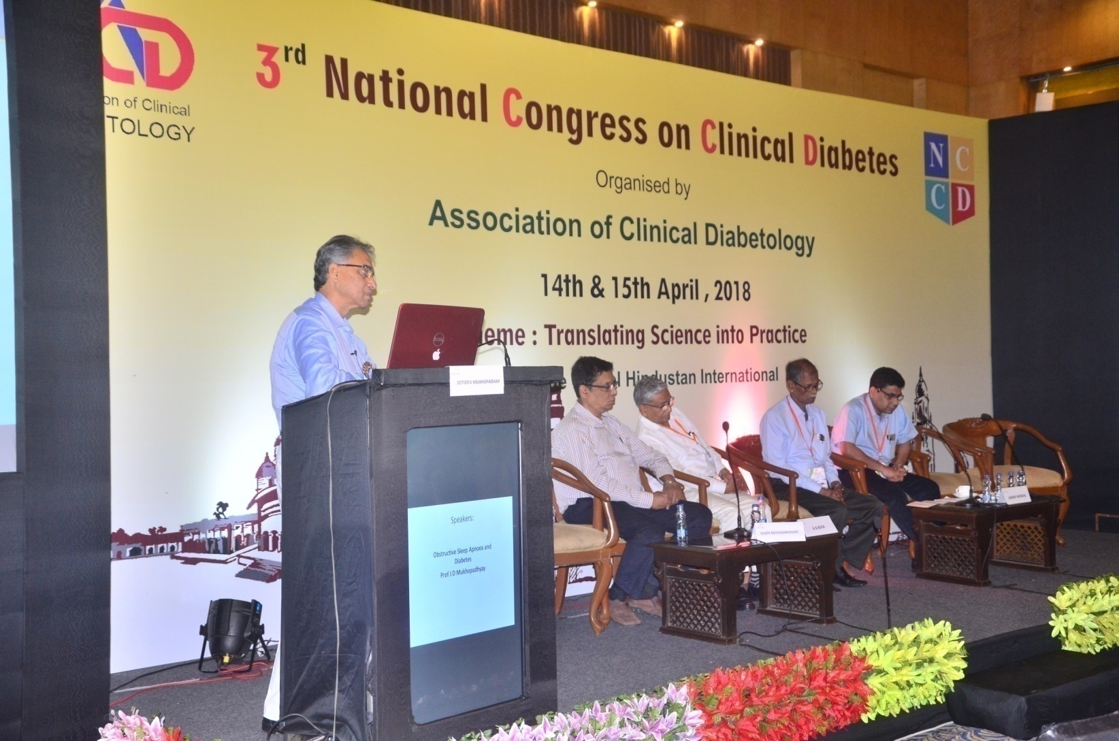
10. Prof. Jotideb Mukhopadhyay delivering his lecture on Obstructive Sleep Apnoea and Diabetes

Slide 12
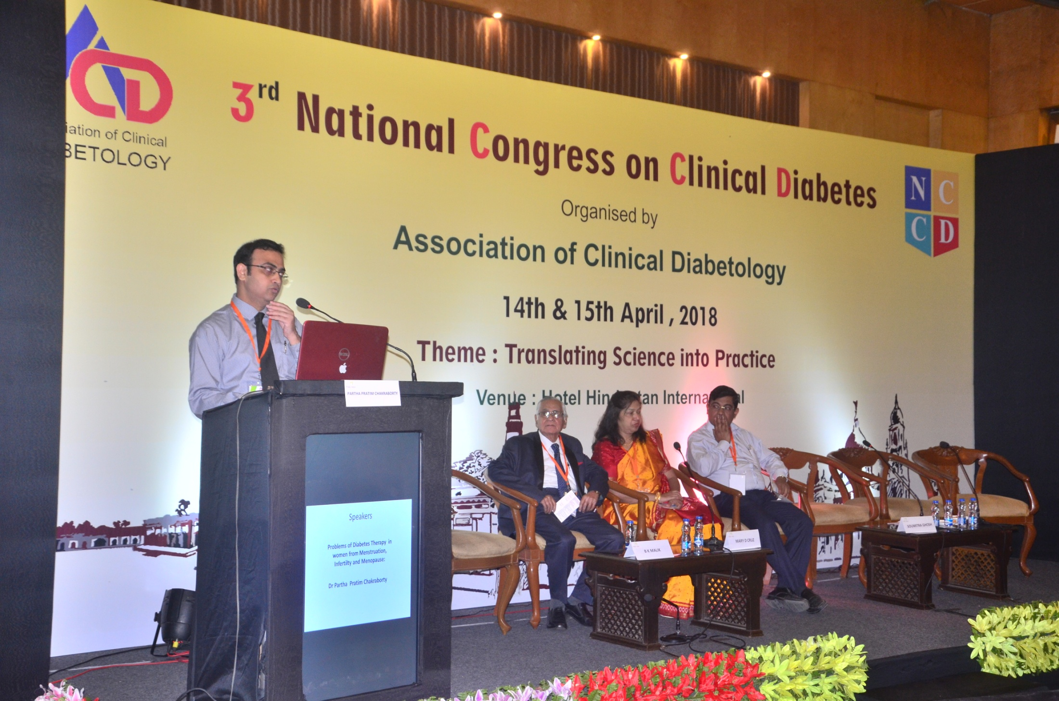
11. Dr P P Chakraborty delivering lecture on Diabetes in Women

Slide 13
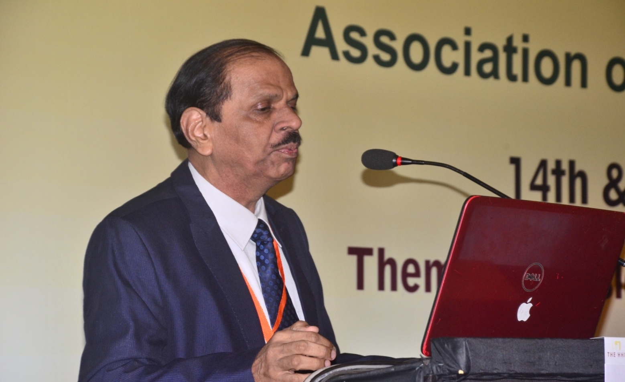
12. Dr Vijay Neglur delivering his lecture on Management of T2D with CKD; DPP4 inhibitors in perspective.

Slide 14
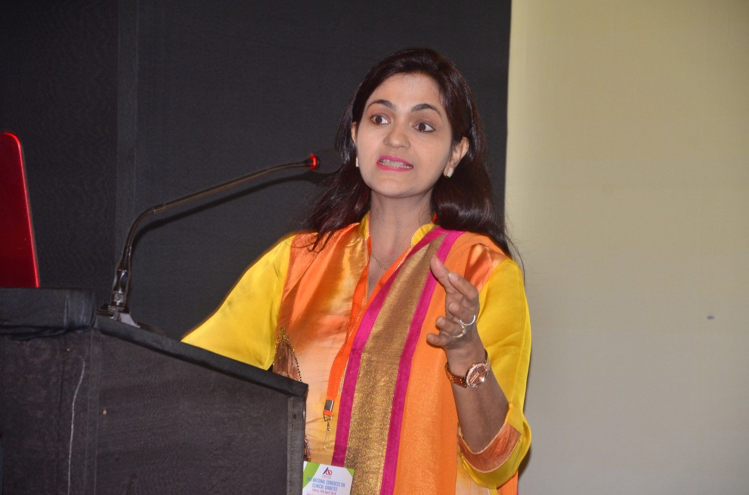
??
13. Kavita Gupta delivering lecture on Diet in Diabetes

Slide 15
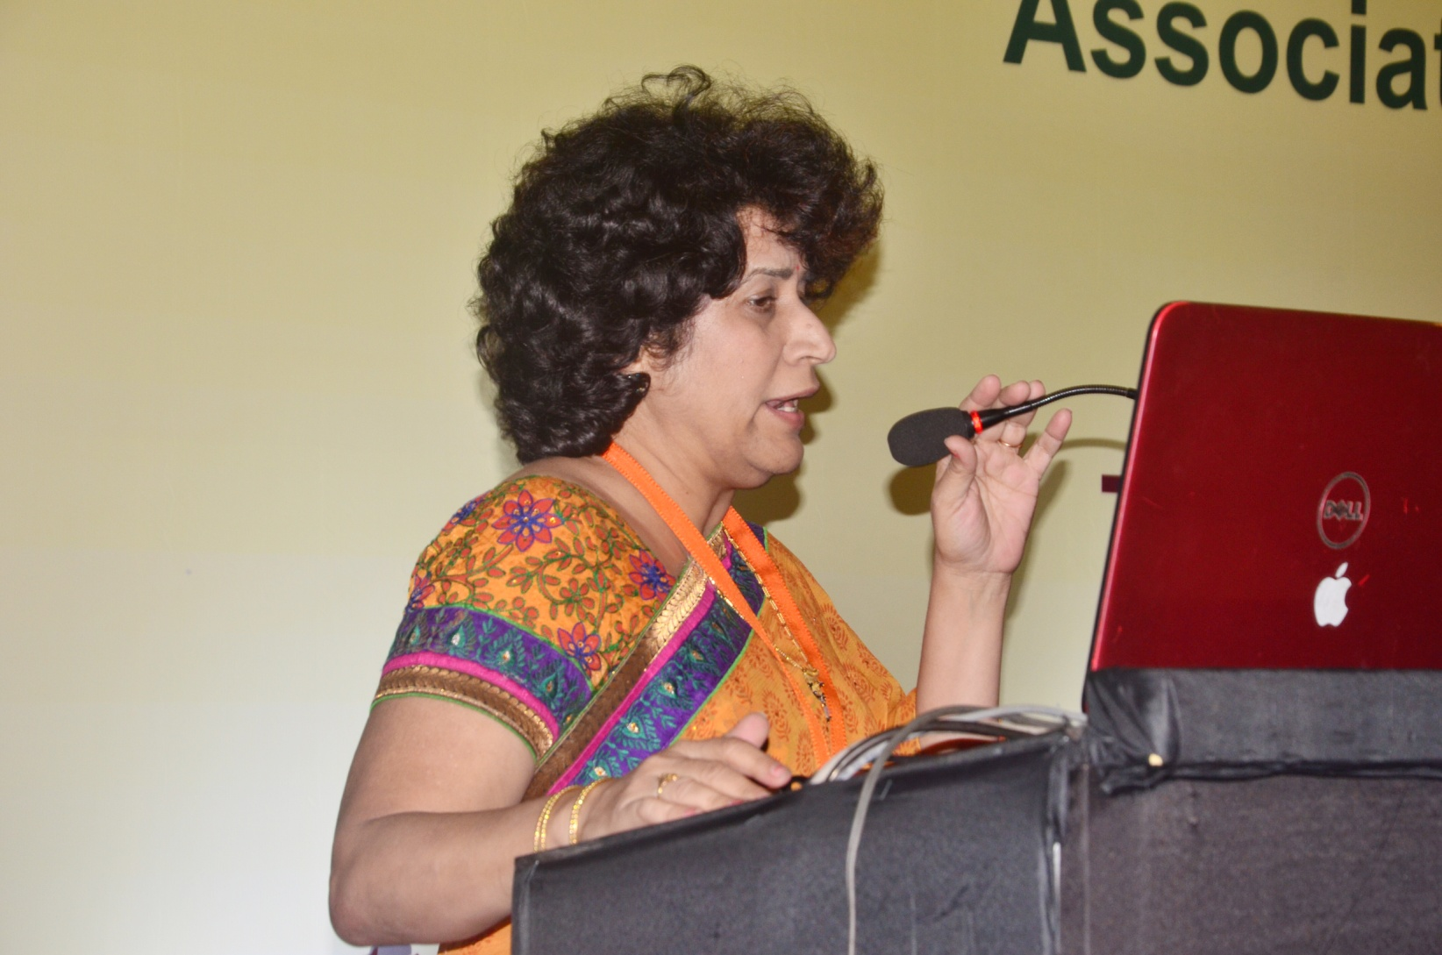
14. Prof Manisha Sahay delivering her lecture on Early Biomarkers in Diabetic Kidney Diseases

Slide 16
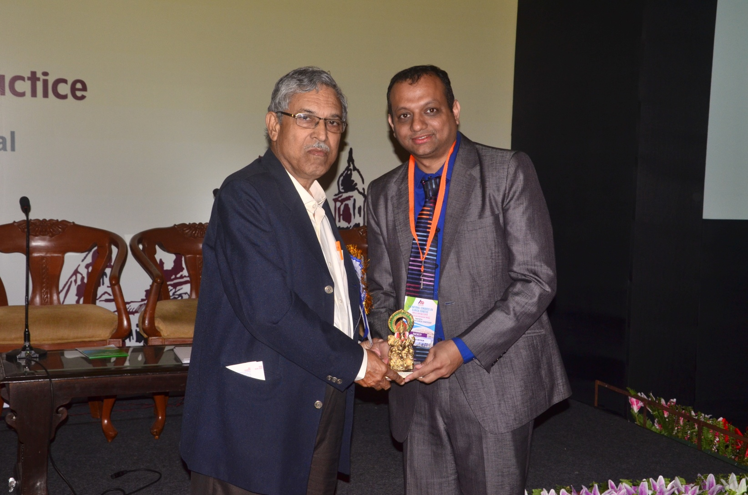
15. Dr Mithun Bhartiya receiving a memento from Prof. Samar Banerjee for his lecture on Phracogenomics in Diabetes treatment
Notes:
e

Slide 17
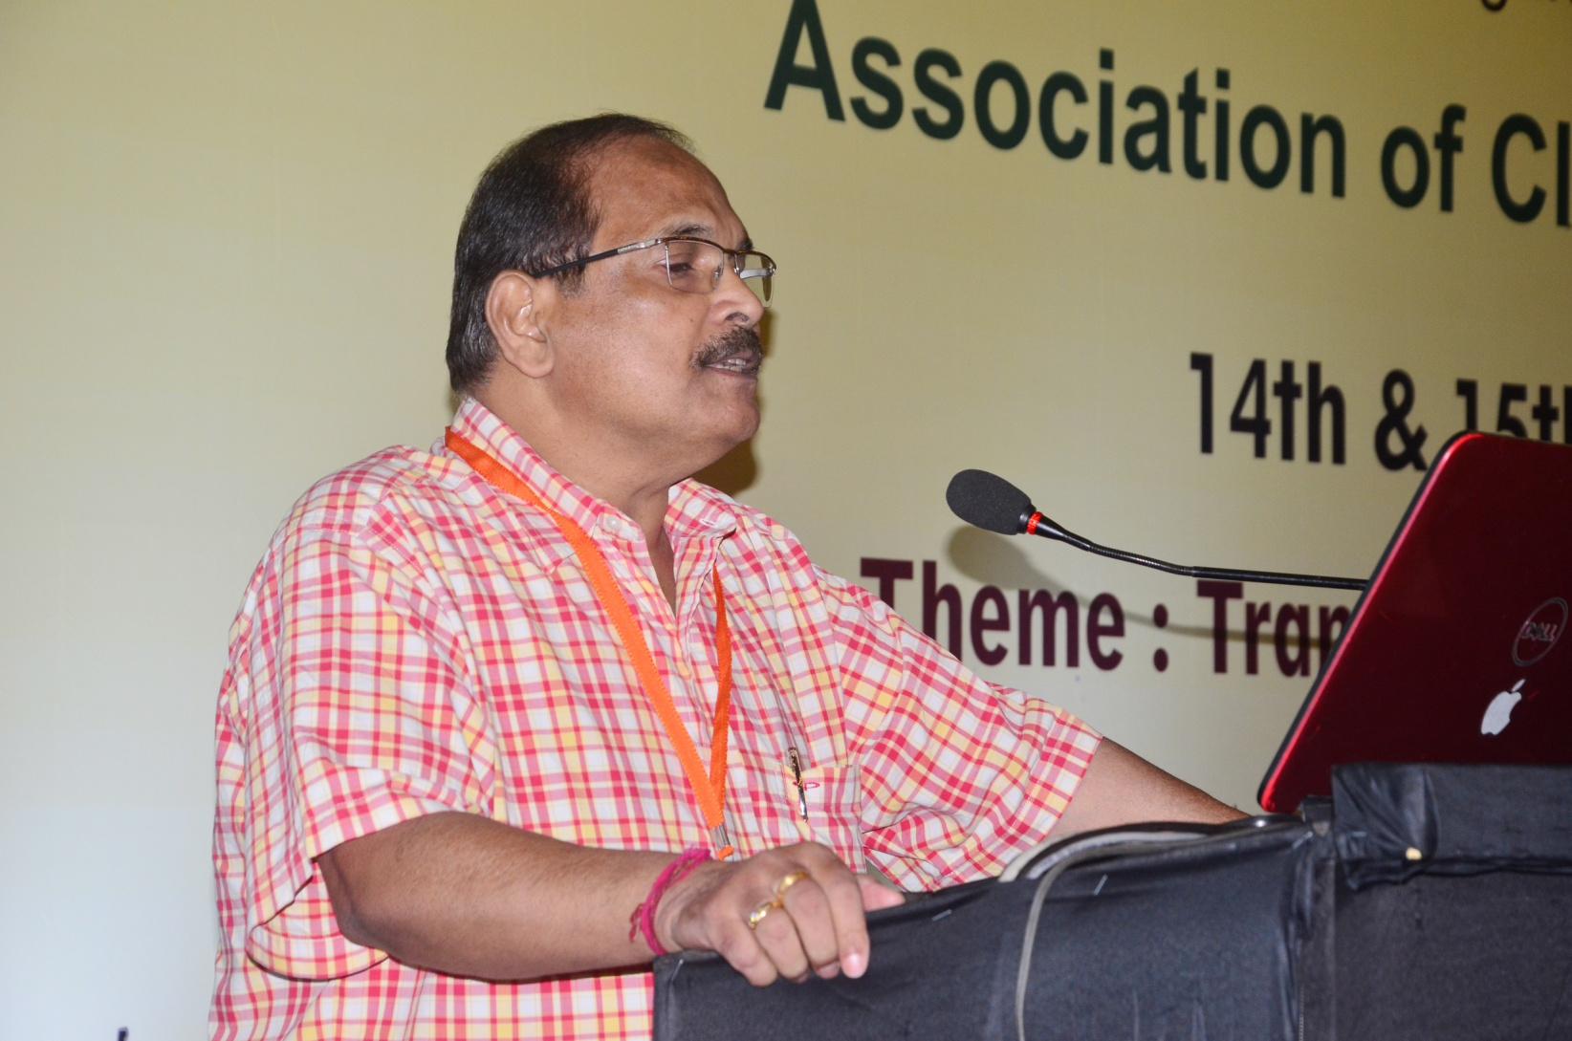
16. Dr. Alok Kanungo delivering his lecture on Next Generation Basal Insulin, Redefining Glycemic Control

Slide 18
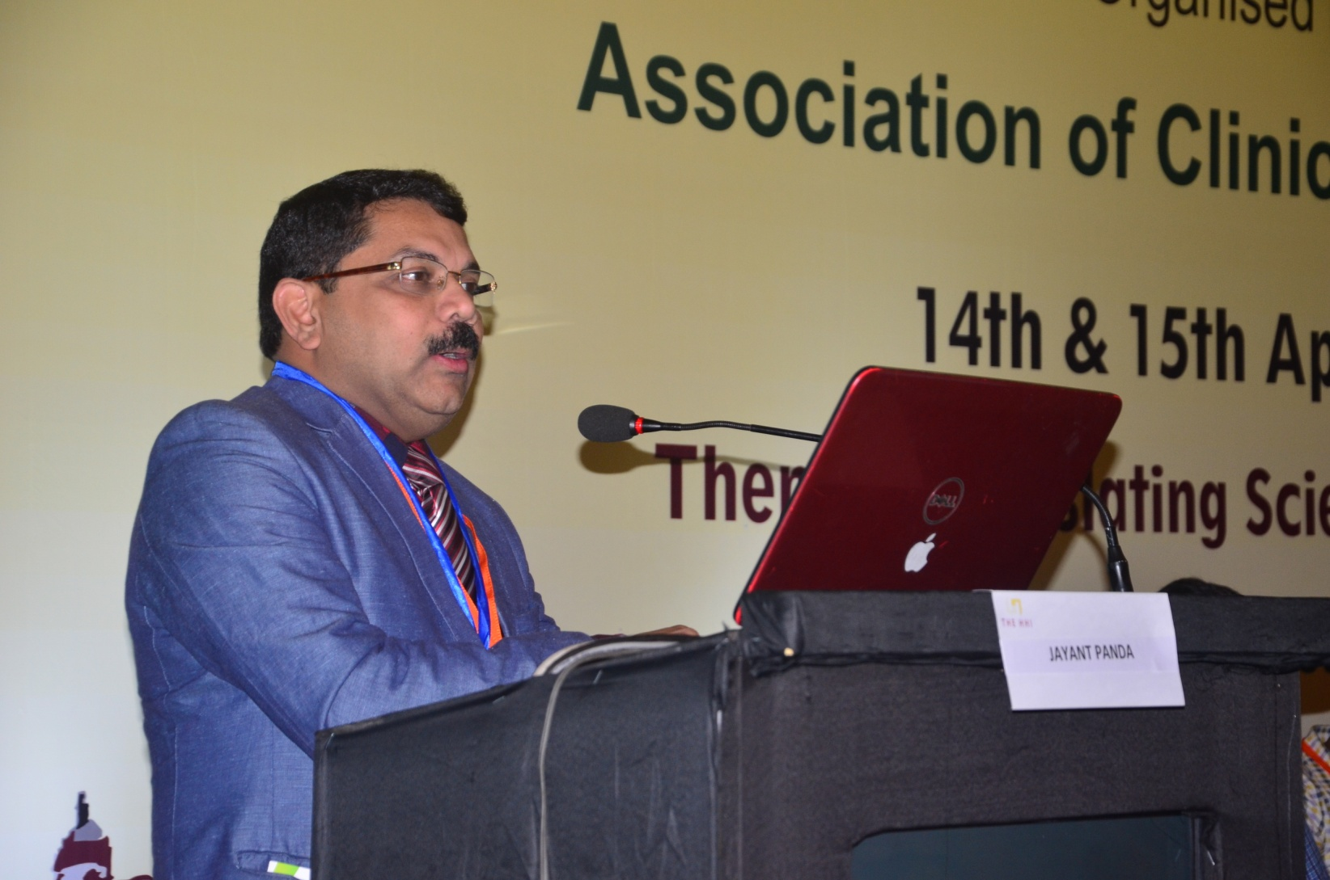
17. Prof Jayant Panda delivering his lecture on Infections typical to Diabetes in India and their atypical management

Slide 19
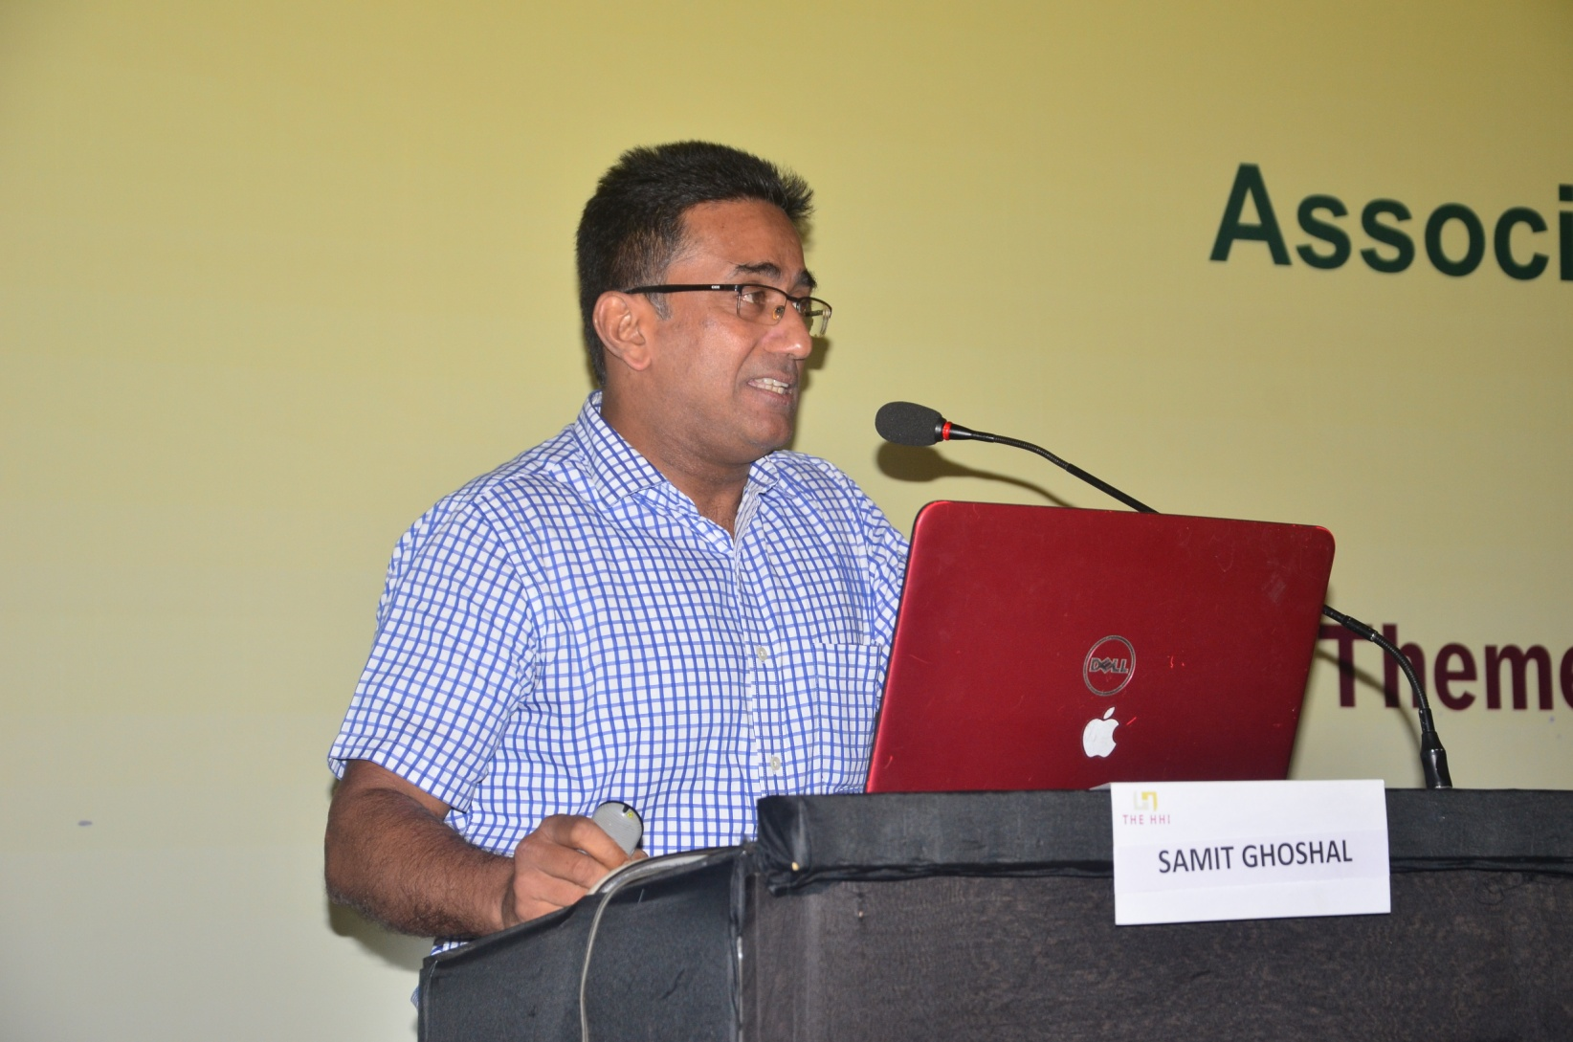
18. Dr. Samit Ghosal delivering his lecture on Tailoring anti-diabetes treatment in the era of CVD risk management , during the plenary session

Slide 20
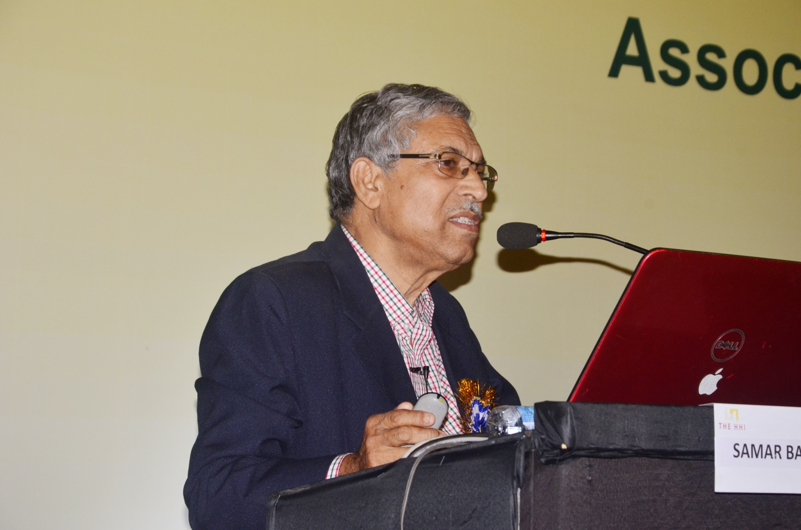
19.Prof. Samar Banerjee delivering his lecture on Fixing from the 1st hour of PPG, possibilities with ultra fast insulin

Slide 21
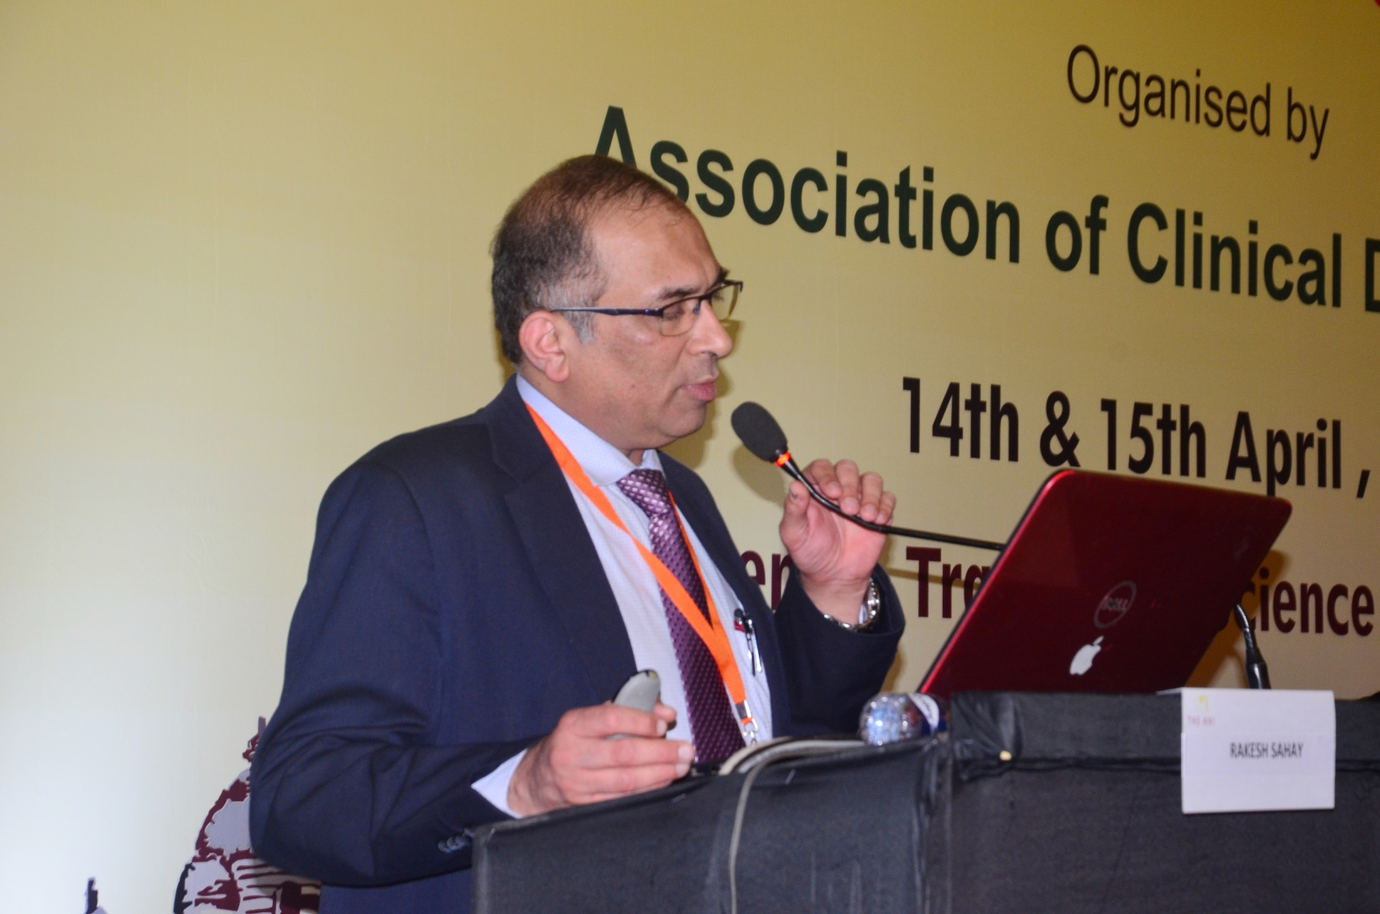
20. Prof Rakesh Sahay delivering his lecture on Challenges in the Management of Type 1 DM: How far have we succeeded ?

Slide 22
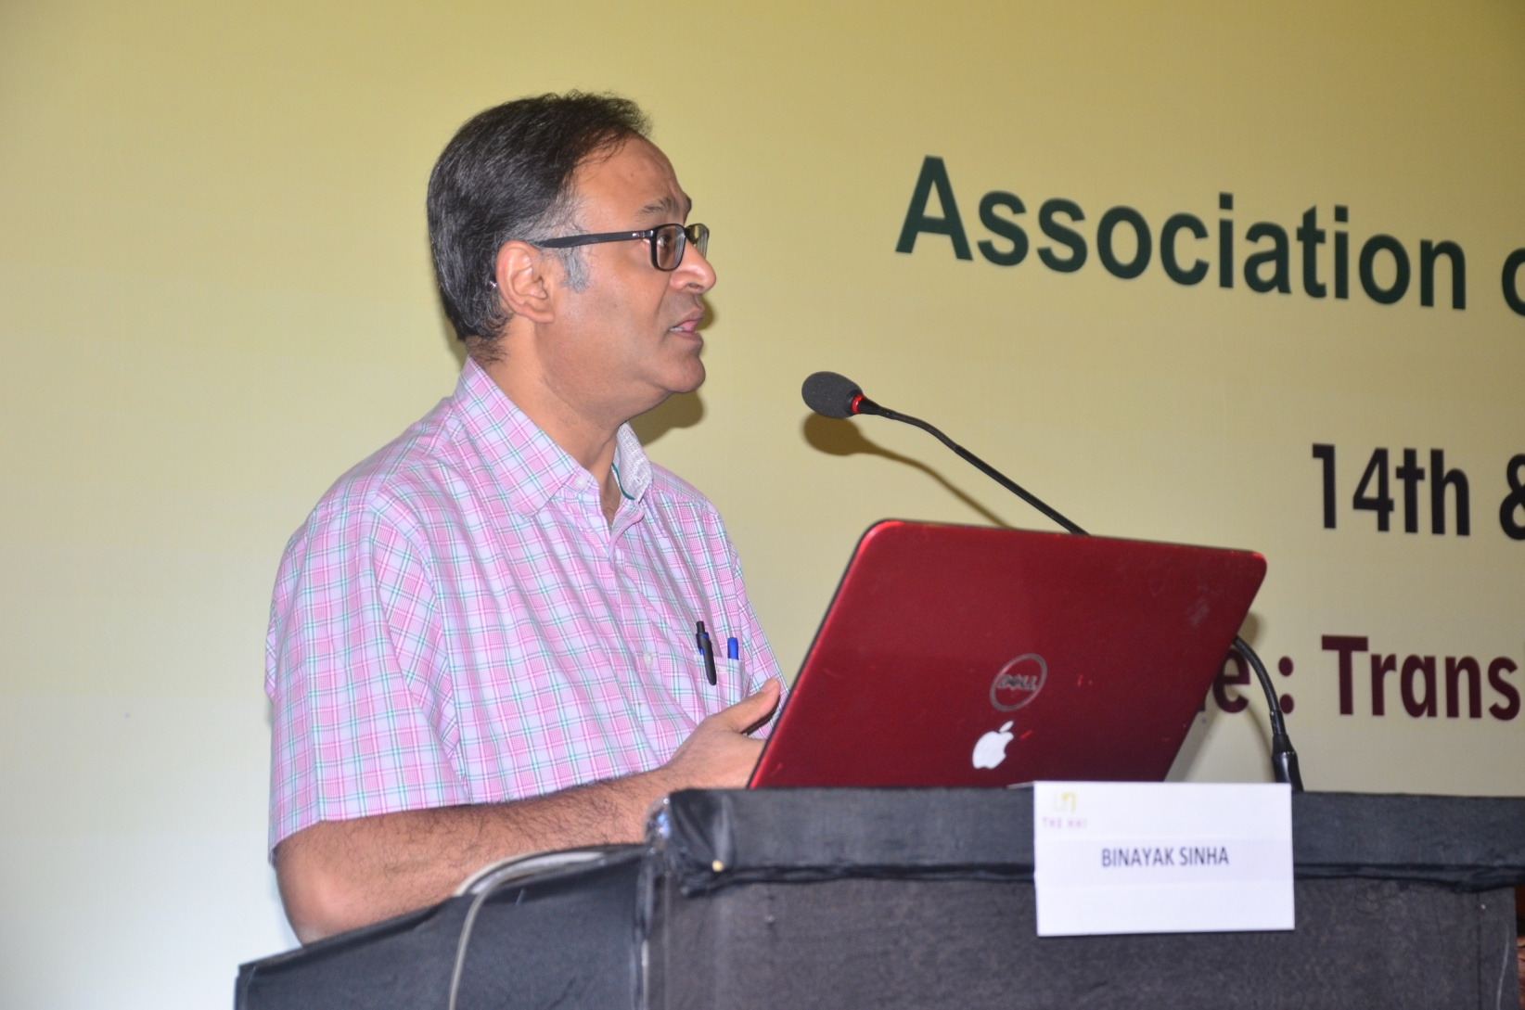
21. Dr Binayak Sinha delivering his lecture on Empowering Cardio-metabolic Outcomes in T2DM Lessons Post EMPA-REG Outcome

Slide 23
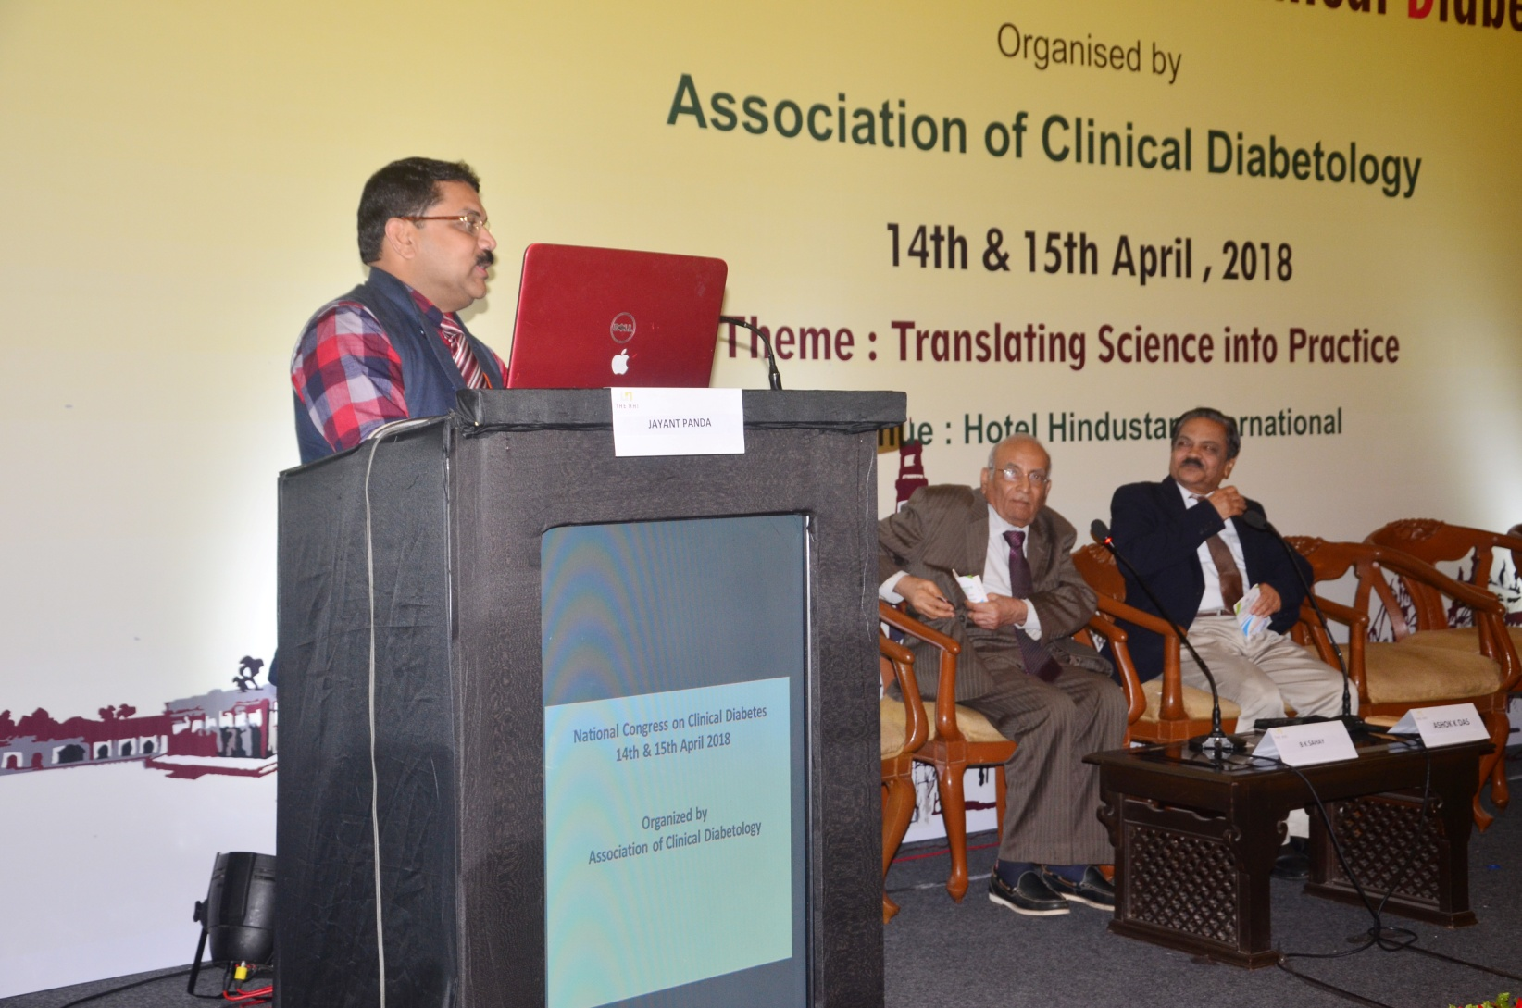
22. Prof. Jayant Panda delivering his lecture on Evidences for SU

Slide 24
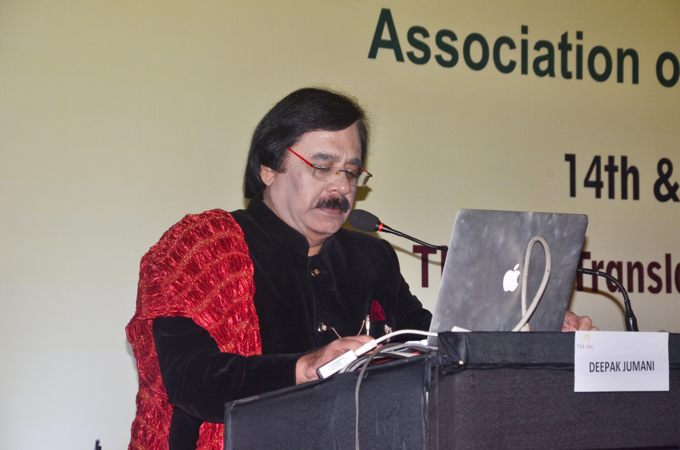
23. Dr. Deepak Jumani delivering his lecture on Erectile Dysfunction is a Correctible Dysfunction.

Slide 25
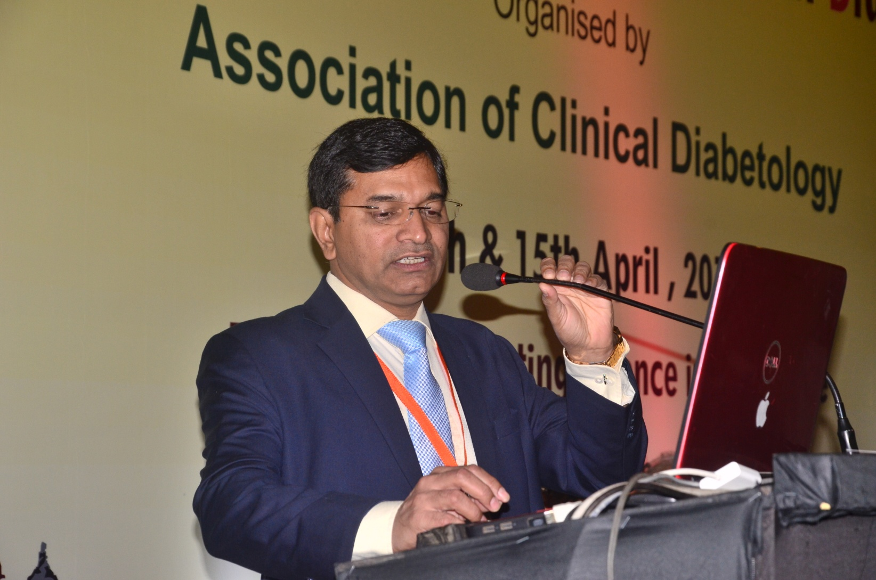
24. Dr Sunil Gupta delivering his lecture on Oral Anti Diabetics in T1DM

